Slide 1


Week 7
1

Slide 2
Index
2
Sr no | index
1 | Base bracket assembly
Sr. no
1
2
3
4
5
Contents
Week1Sketch1
Week1Sketch2 Week1Assignment1
Week1Assignment2 Insights

Slide 3
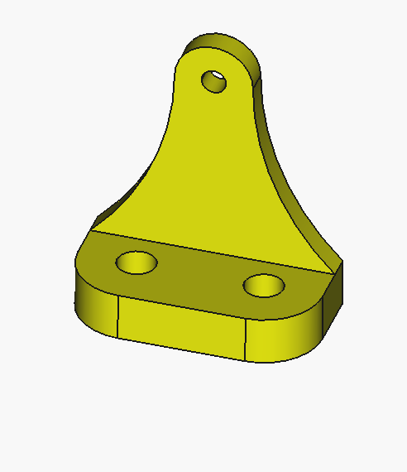
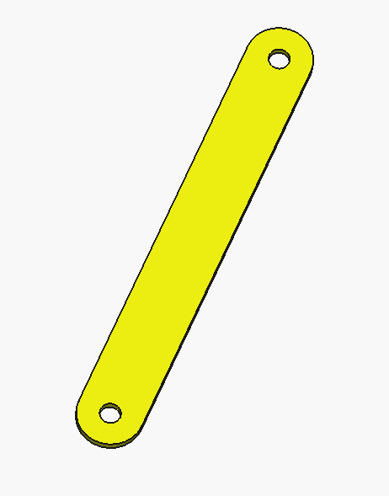
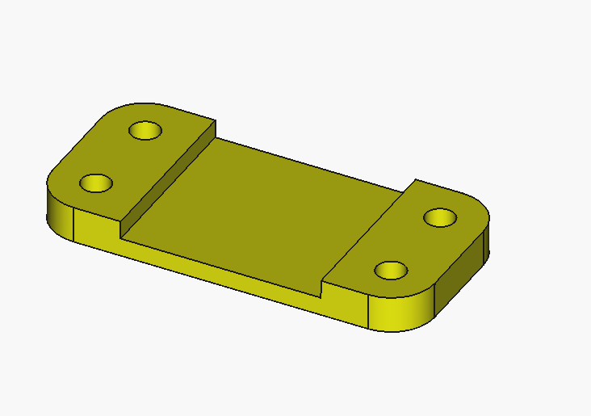
Different parts
Bracket
Base
Link

Slide 4
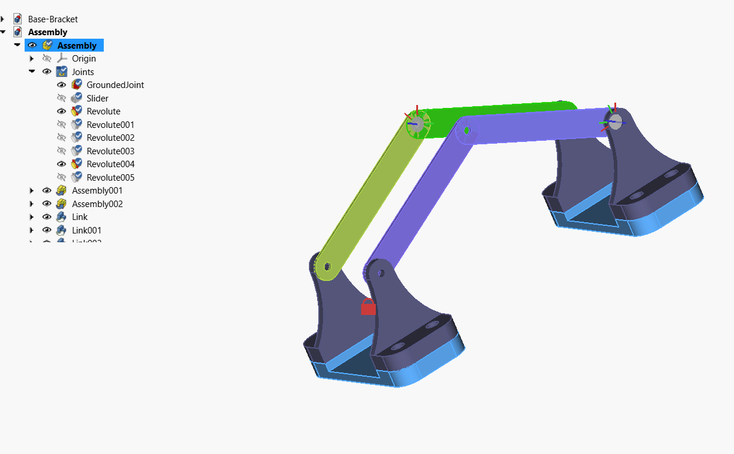
Final Assembly

Slide 5
Insights
How to convert individual part models into a complete functional assembly
The importance of dimensional accuracy for proper fittingHow to use different joints to restrict or allow movement
The role of alignment in maintaining strength and rigidityHow base brackets support and hold other components in position

